Slide 1
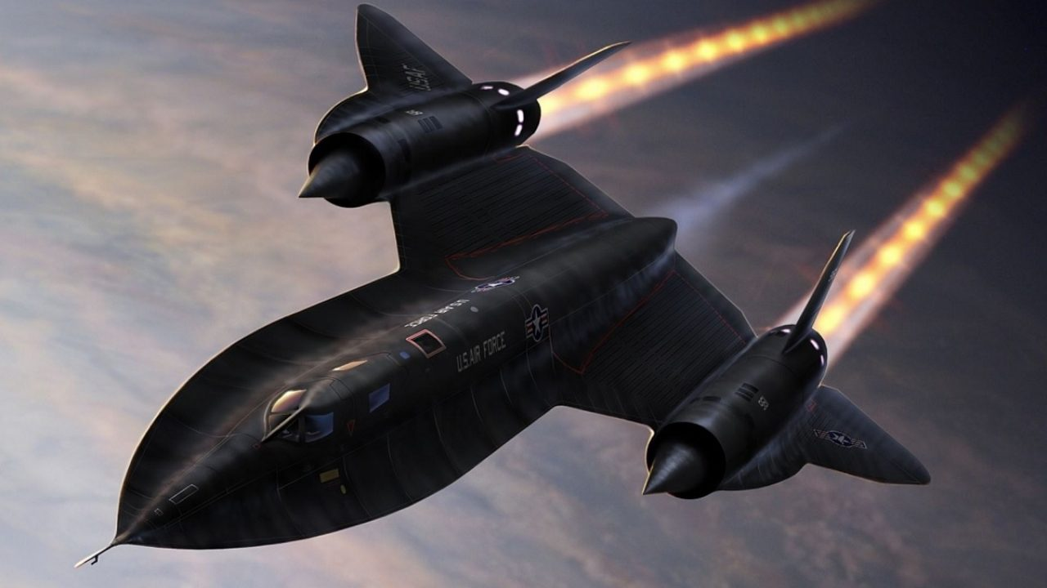
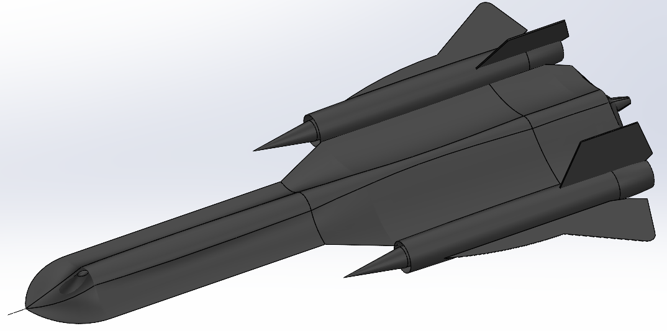
Solidworks Final Project
AERE161
Lockheed SR-71A Blackbird
Group A5 Members:
Nick McCullough, Josh Hediger, Ryan Dunn, Akhilesh Nevatia, David Lane
Notes:
Nick – starts. Each member introduces themselves

Slide 2
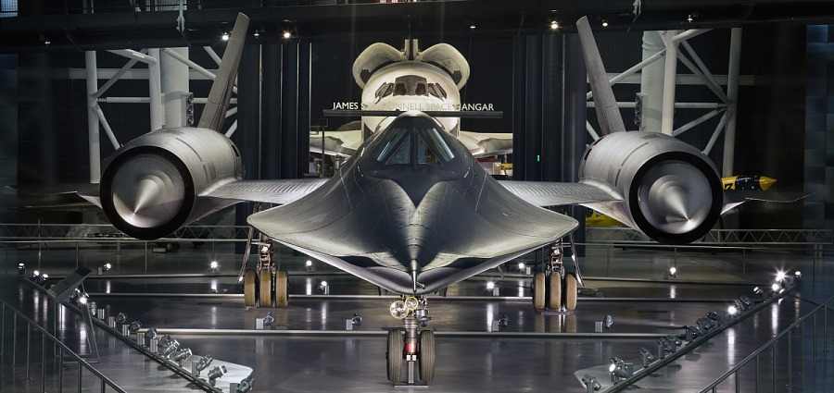
History
Designed secretly in the 1950’s by Lockheed Martin for reconnaissance missions by the U.S. Air Force
The aircraft was designed to reach Mach 3.2 (2,200+ mph) and is one of the fastest jet-powered, piloted aircraft ever created
The U.S. Air force retired the Blackbird in 1998 and NASA retired the Blackbird 1999
Notes:
Nick

Slide 3
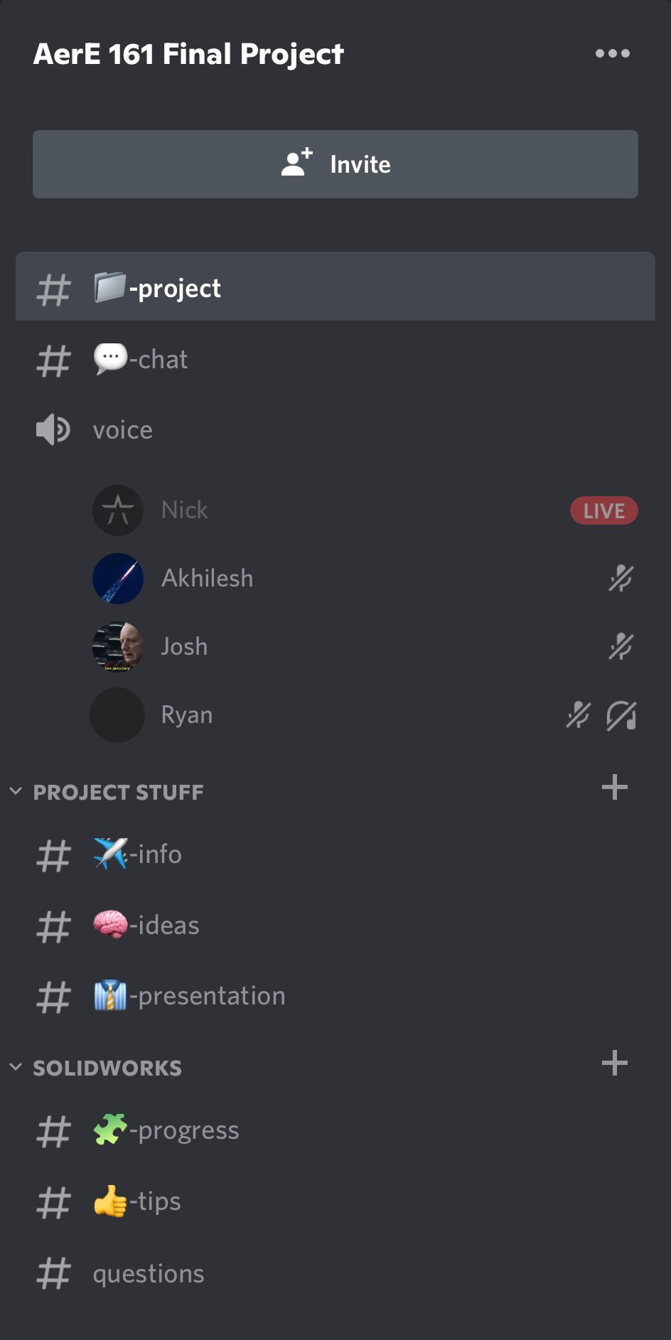
Communication
Created a discord server to communicate, share ideas and work together virtually on the project
Google Drive for Solidworks parts
Made by Nick
The server has multiple sections:
Project
Chat
Voice
Ideas
Presentation
Progress
Tips
Notes:
Nick

Slide 4
Timeline
28 Mar.
Collectively decided on SR-71 Blackbird while in class
29 Mar.
Rough pre-plan discussed
31 Mar.
Discussed rough dimensions of the plane in discord
4 Apr.
Met in Howe Hall to construct the front portion of fuselage
4 Apr.
Met in innovation building to construct engine, rudders, start rear fuselage
16 Apr.
Met in Howe Hall to begin cockpit, finishing touches, rear fuselage continued
24 Apr.
Met in innovation building to finish rear fuselage, worked on PowerPoint
29 Apr.
Finish Assembly in Innovation Building,
Due Date
Notes:
Nick

Slide 5
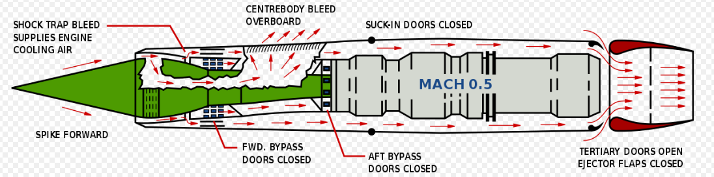
THEORY (Similarity ratios)
Pratt & Whitney J58 turbojet engine
Many dimensions were not included
Decided not to include landing gear
Notes:
Josh

Slide 6
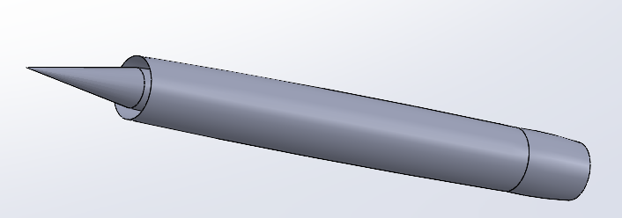
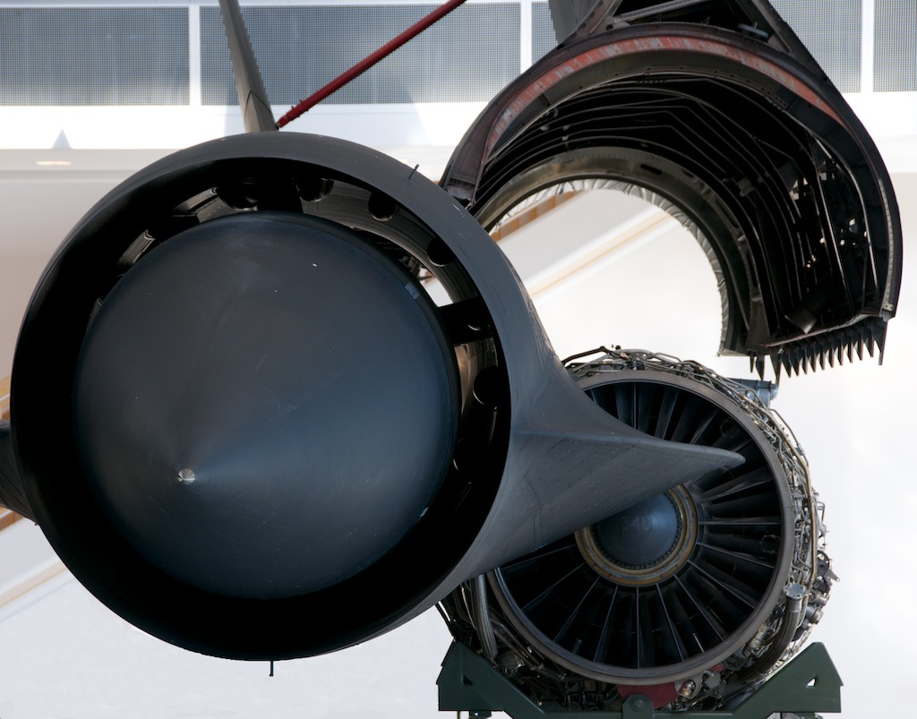
Engine
Turbojet Engine
Conical inlet spike (ramjet)
Made by Josh
Notes:
Josh

Slide 7
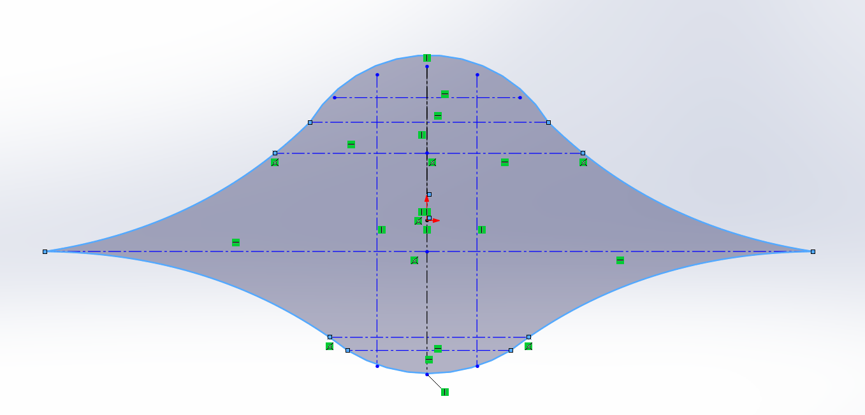
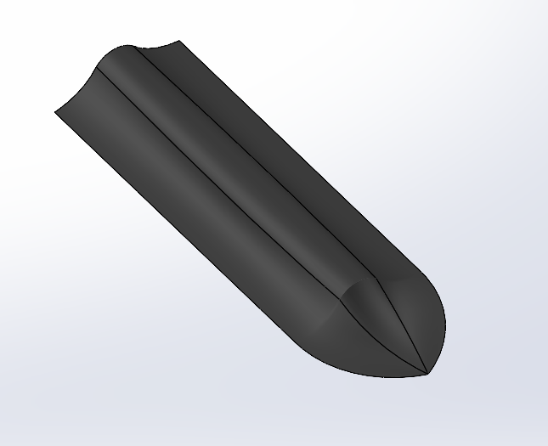
Front Fuselage (CHINE)
Starting point
Extruded this 2D sketch to a scaled length to the front of the aircraft
Started with given 5.33’ diameter
Made by Josh and David
Starting Point
Front Fuselage
Notes:
Ryan

Slide 8
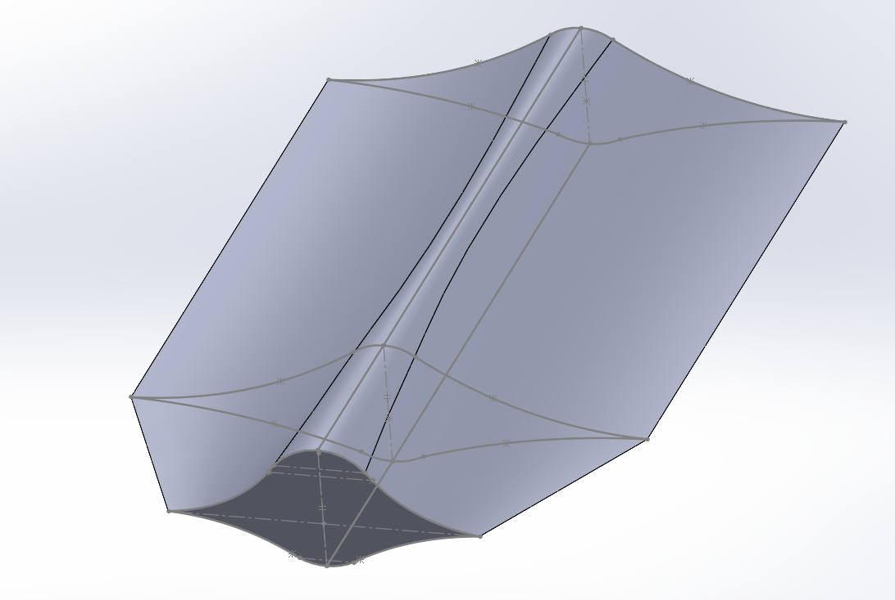
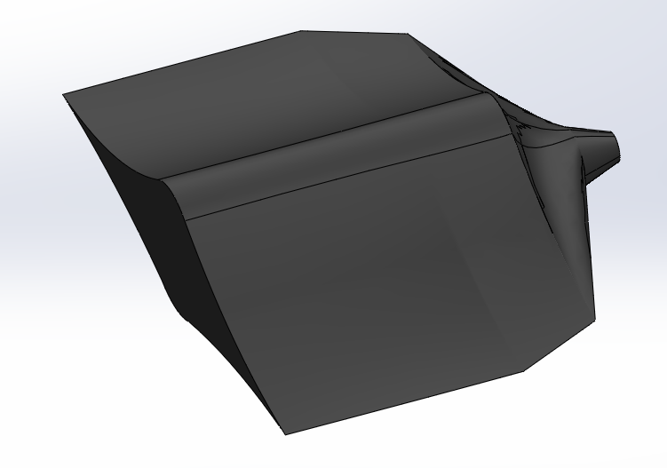
Rear FuselagE (ChINE)
Split in two sections
Rear Fuselage Front made by Josh and Nick
Rear Fuselage Back made by Ryan
R. Fuselage Front
R. Fuselage Back
Notes:
Ryan

Slide 9
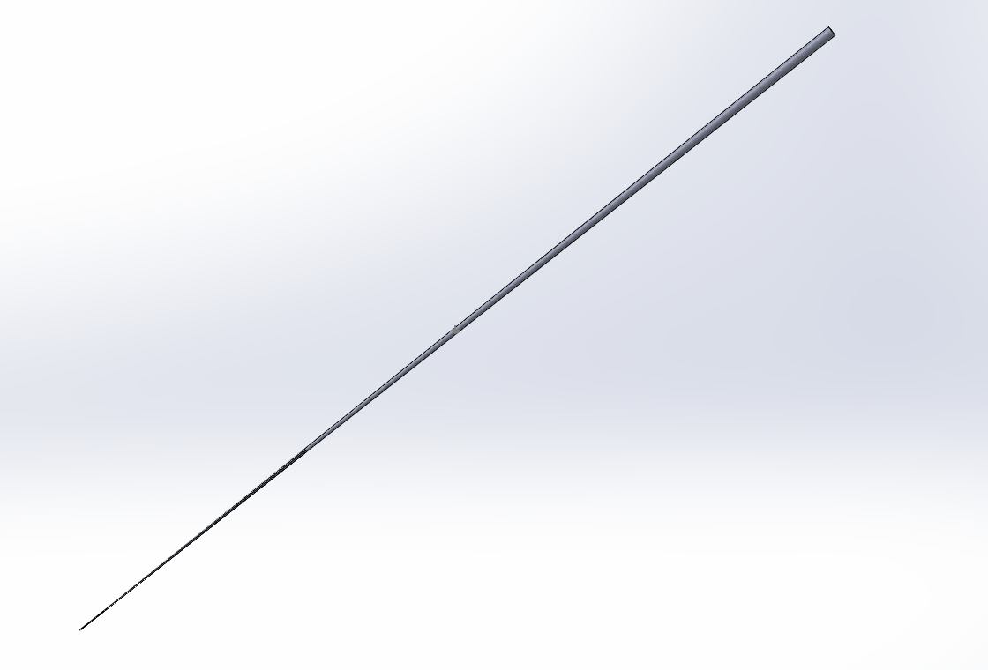
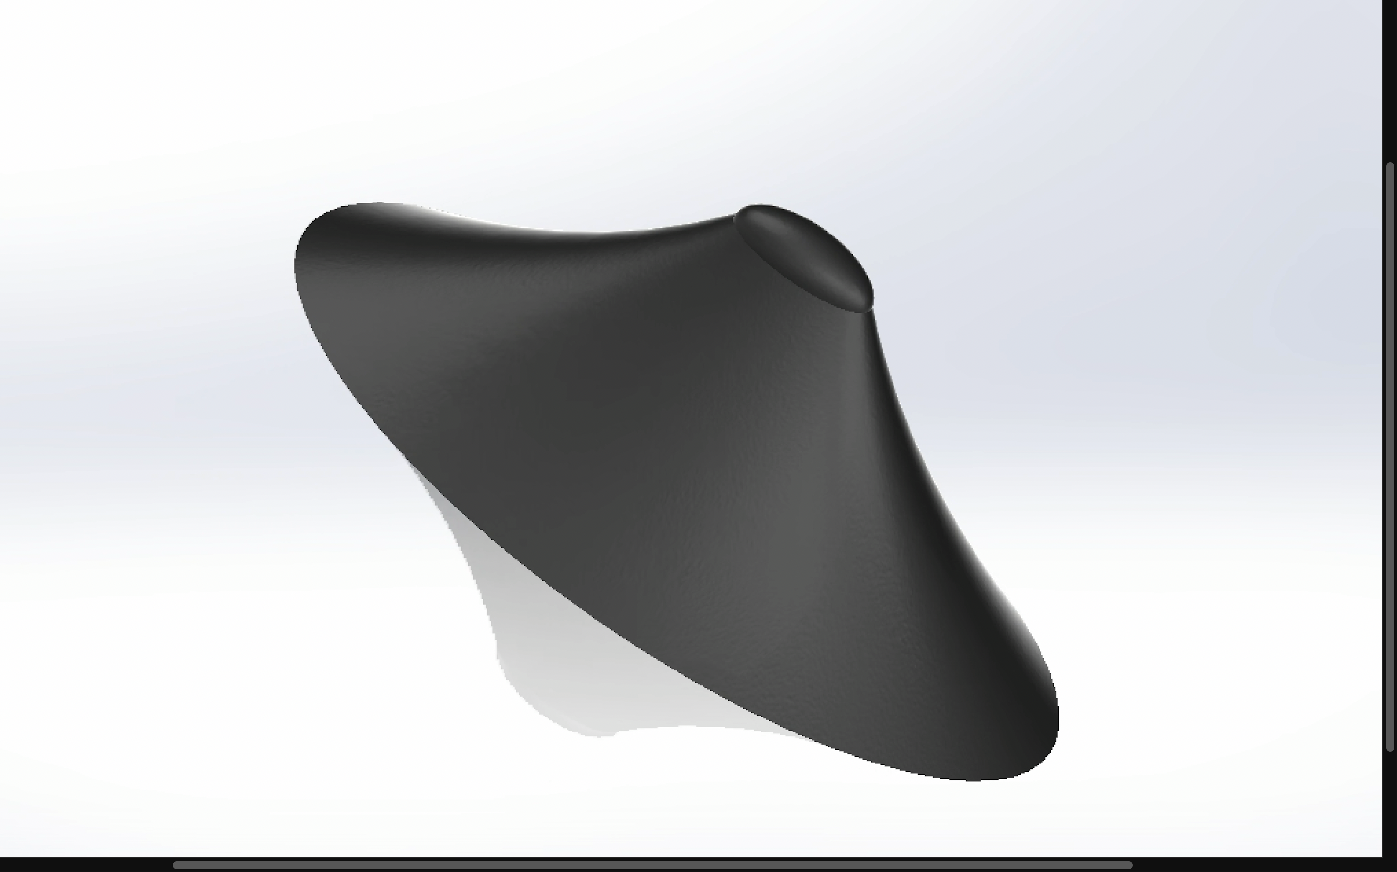
Pressure gauge & COCKPIT
Each lofted using multiple references planes
Ellipses for cockpit, base is 1/3 fuselage width
Cockpit made by Akhilesh
Pressure Gauge made by Akhilesh and David
Pressure Gauge
Cockpit
Notes:
Akhilesh

Slide 10
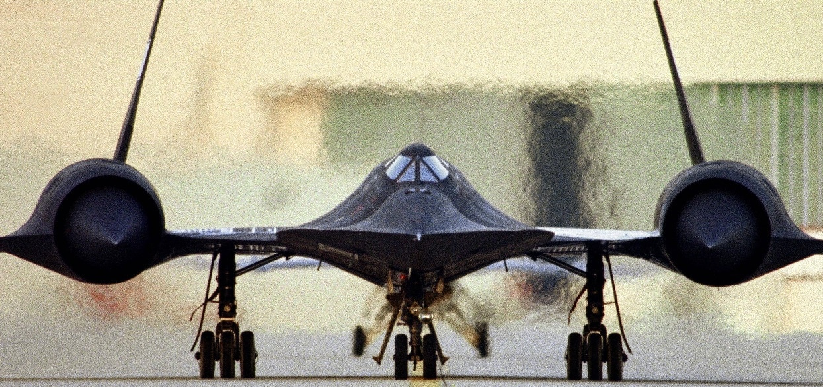

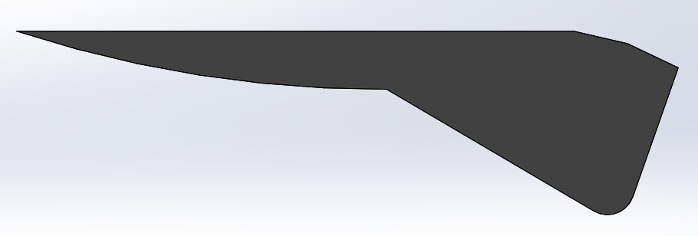
Rudder & wingtip
Rudder angle 17 degrees
Both extruded from a 2D sketch
Rudder made by Josh
Wingtip made by Ryan
Rudder
Wingtip
Notes:
Akhilesh

Slide 11
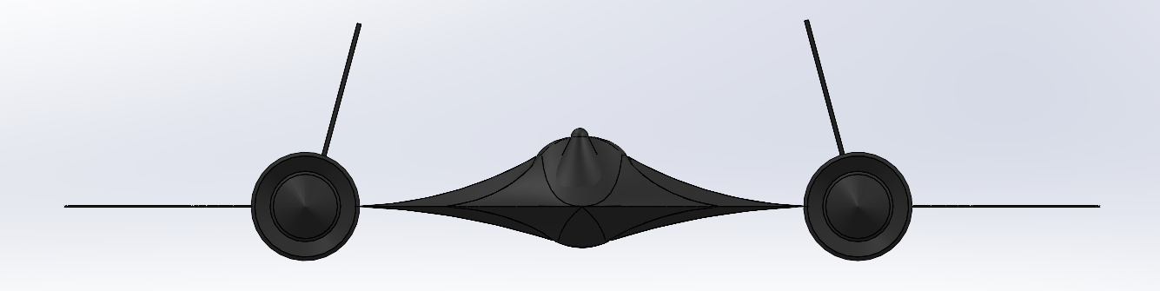
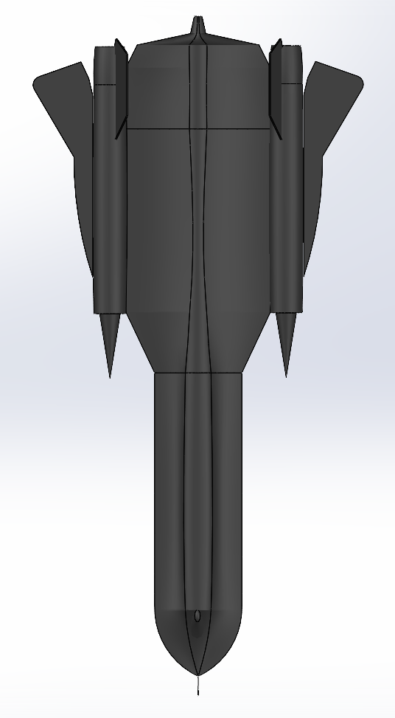

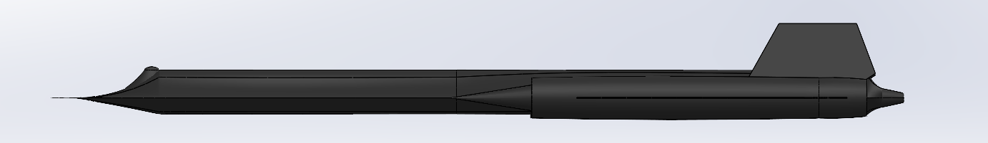
ASSEMBLY
Notes:
David

Slide 12
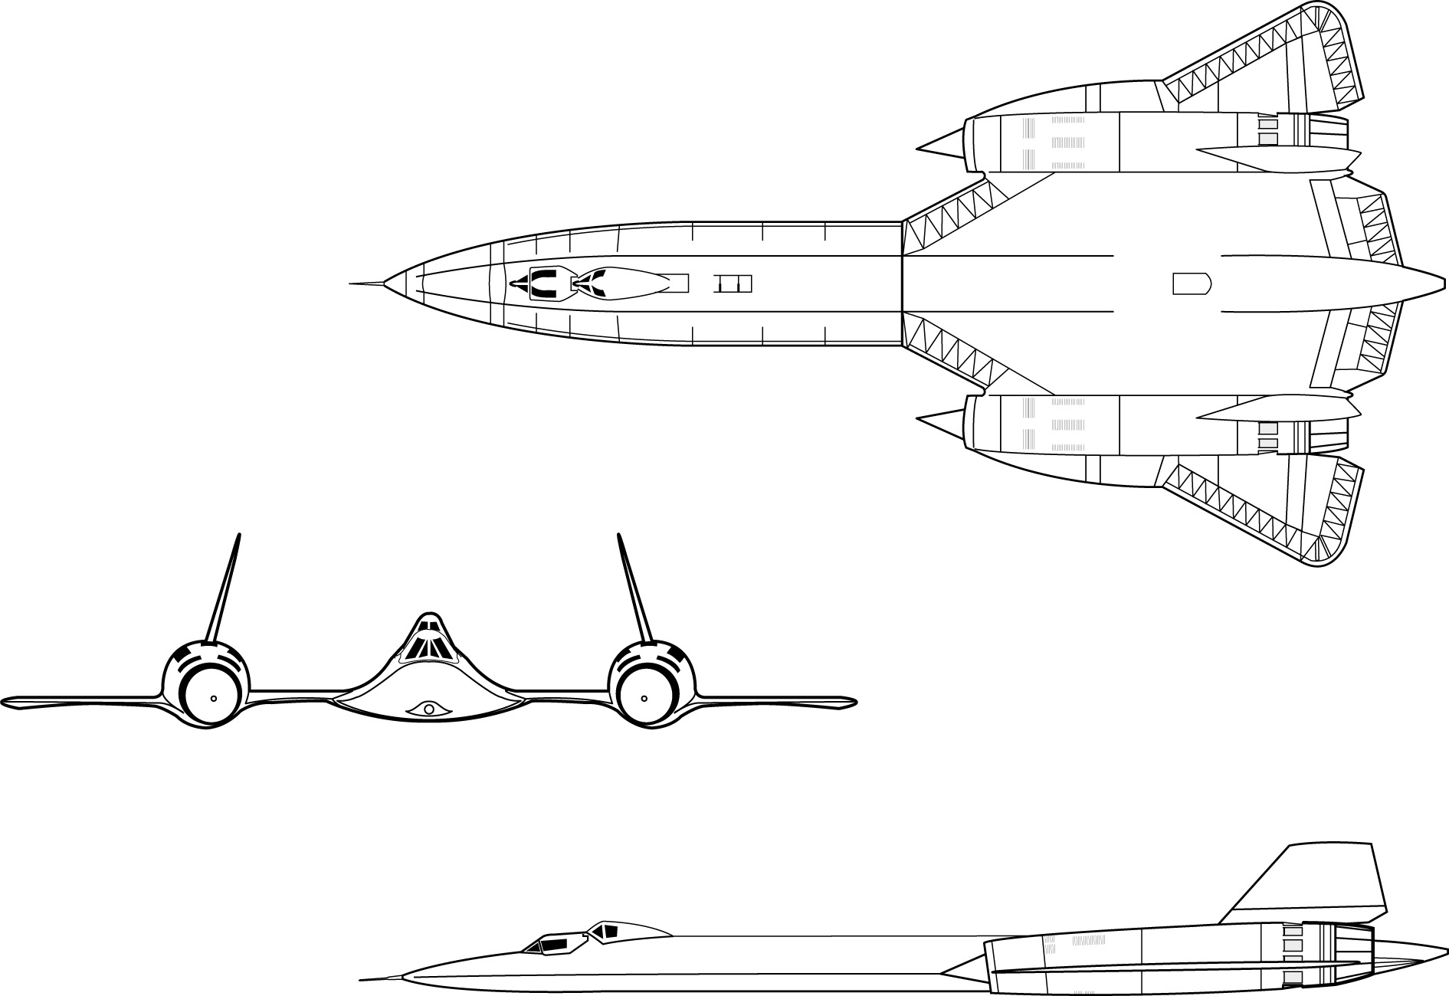
Resources
We sourced most of our information from these websites:
https://www.nasa.gov/centers/armstrong/news/FactSheets/FS-030-DFRC.html
https://www.sr-71.org/blackbird/sr-71/
https://en.wikipedia.org/wiki/Lockheed_SR-71_Blackbird
https://aerocorner.com/aircraft/lockheed-sr-71-blackbird/
http://www.fiddlersgreen.net/models/aircraft/Lockheed-SR71.html
Similarity Ratios
Notes:
David

Slide 13
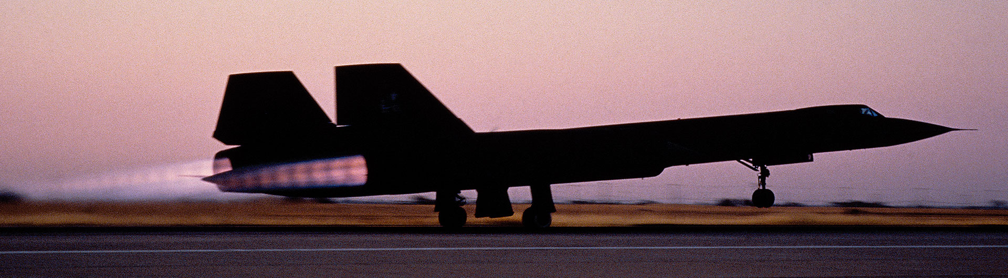
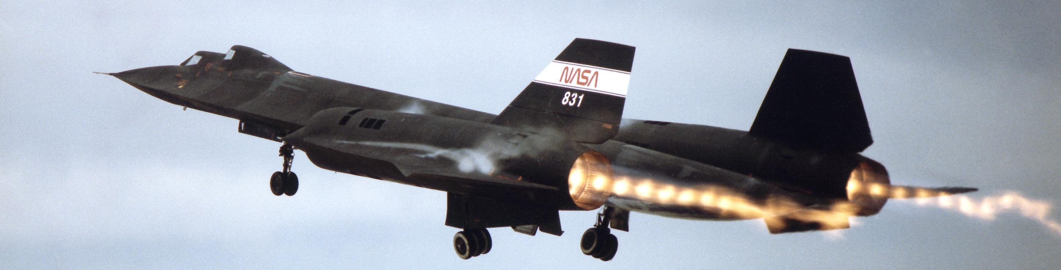
Questions?
SR-71A
SR-71B
Notes:
David - closes

